Slide 1
Giving & Receiving
Matthew 7:6–12
Andrew Spurgeon
Uploaded by Dr. Rick Griffith, Crossroads International Church Singapore
www.BibleStudyDownloads.org

Slide 2
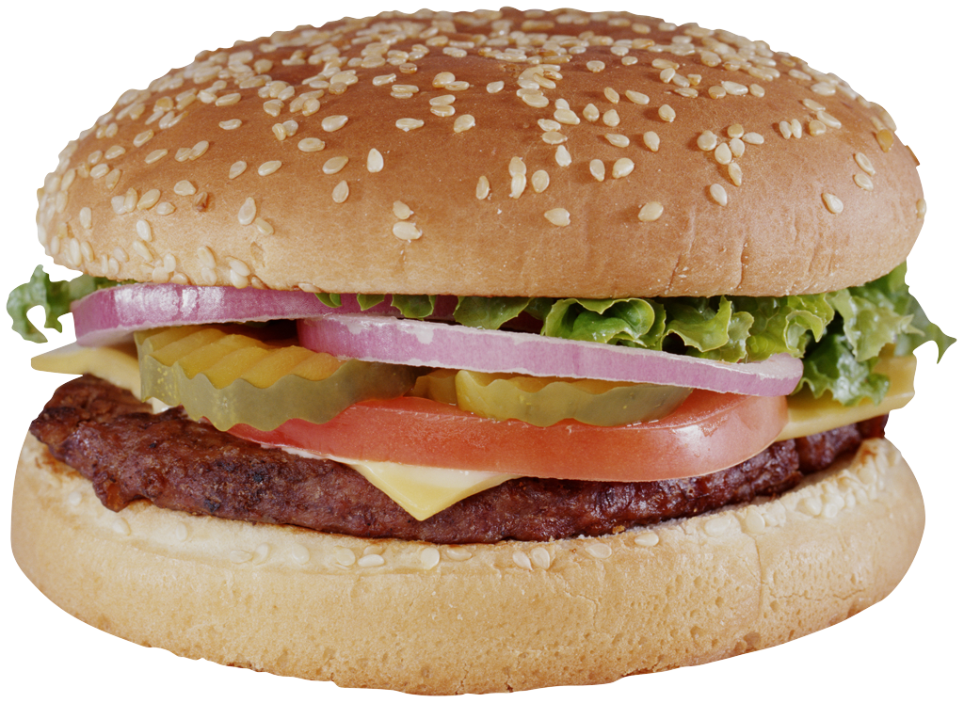
Matthew 7:6–12
Proper giving (Matt 7:6)
Proper receiving (Matt 7:7–11)
Proper giving (Matt 7:12)

Slide 3
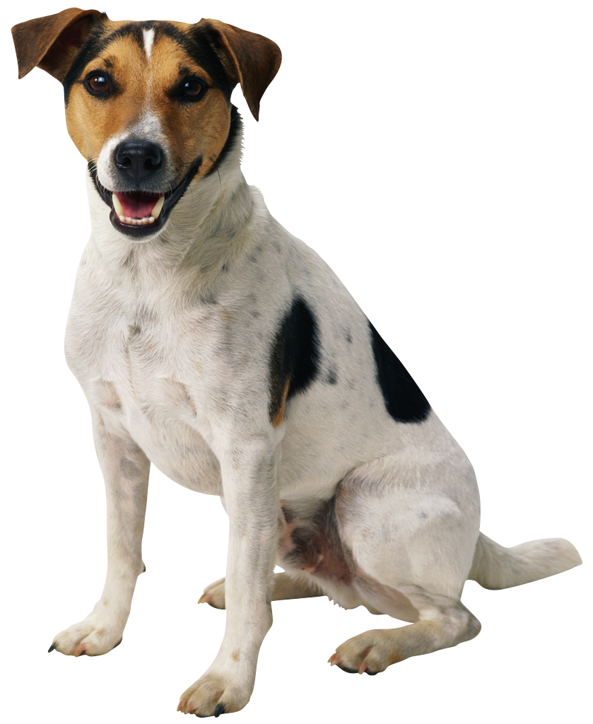
Proper Giving (Matt 7:6)
“Do not toss the holy things to the dogs” (7:6a)
Exodus 22:31 said, “Be holy people, i.e., don’t eat animals torn in the field by wild-beasts; instead, toss that meat to the dogs.”
Properly killed animal were sacred meat (kosher); animals accidentally killed were unholy meat—fit only for the dogs.
I.e., Kosher meat is not for the dogs!

Slide 4
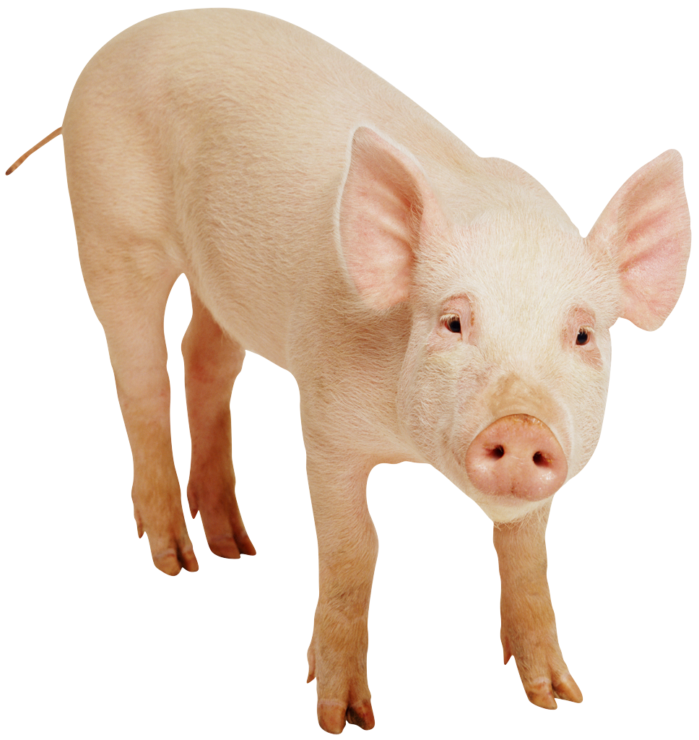
Proper Giving (Matt 7:6)
“Do not throw your pearls before the pigs” (7:6b)
Deuteronomy 14:7 said, “The pig is unclean although it has a split hoof; it does not chew the cud. You are not to eat their meat or touch their carcasses.”
Proverb 11:22 said, “Like a gold ring in a pig’s snout is a beautiful woman who shows no discretion.”
I.e., Valuable things are not for unclean pigs.

Slide 5
Proper Giving (Matt 7:6)
“Because, they stomp on them [kosher; pearls], turn around, and attack you!” (7:6c)
The dogs don’t understand the importance of kosher meat; the pigs don’t understand the importance of pearls.
Instead, their instinct is wasting and attacking.

Slide 6
Proper Giving (Matt 7:6)
Proper giving = giving to the person who values
Canaanite woman (Matt 15:21–28)
Multiplying servant (Matt 25:14–30)

Slide 7
Matthew 7:6–12
Proper giving (Matt 7:6)
Proper receiving (Matt 7:7–11)
Proper giving (Matt 7:12)

Slide 8
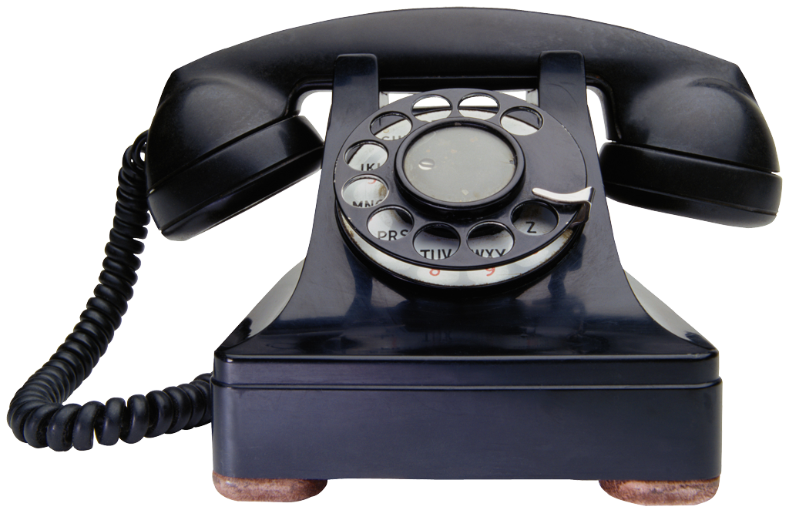
Proper Receiving (Matt 7:7–11)
Ask . . . it will be given to you (7:7a)
Everyone who asks receives it (7:8a)
A little grammar: divine passive (ask . . . it will be given to you by God); gnomic (milk is white; “receives” is the norm)
James 1:5; 4:2–3
Matthew 7:9–11

Slide 9
Proper Receiving (Matt 7:7–11)
Seek . . . you will find (7:7b)
Everyone who seeks [something] finds it (7:8a)
Grammar: it’s active voice; gnomic
Matthew 13:45; 18:12; Luke 15:8

Slide 10
Proper Receiving (Matt 7:7–11)
Knock . . . it will be open to you (7:7b)
Everyone who knocks [on a door] it will be open to him/her (7:8a)
Grammar: back to passive voice; gnomic
Matthew 7:13–14; [Next week’s lesson]

Slide 11
Proper Receiving (Matt 7:7–11)
Ask . . . it will be given to you (7:7a)
Everyone who asks receives it (7:8a)
Matthew 7:9–11
If a son asks for a bread, will a father give a stone?
If a son asks for a fish, will the father give a snake?
If you—in your mere humanness, prone to evil—know to give to your children good gifts, will not the heavenly Father give you good gifts? (Luke 11:13)

Slide 12
Proper Giving/Receiving
Proper giving = giving to the person who values
Proper receiving = asking, seeking, and knocking for the good gifts, knowing the character of our heavenly Father
David (2 Sam 12:15–25)
The Lord Jesus (Matt 26:36–44)
James 4:2–3

Slide 13
Matthew 7:6–12
Proper giving (Matt 7:6)
Proper receiving (Matt 7:7–11)
Proper giving (Matt 7:12)

Slide 14
Proper Giving (Matt 7:12)
“Therefore, in everything you expect others to do for you, you likewise do for them” (7:12a)
action = if you expect others to respect you, you respect them first
gifts = if you wish to receive a million $, give a million first (i.e., be generous before you expect others to be generous)
“This is what the law and the prophets say” (7:12b)

Slide 15
Proper Giving/Receiving
Proper giving = giving to the person who values
Proper receiving = asking, seeking, and knocking for the good gifts, knowing the character of our heavenly Father
Proper giving = giving what you wish to receive
2 Cor 8:9; Phil 2:5–11; 2 Cor 9:6

Slide 16
Proper Giving/Receiving
Proper giving = giving to the person who values
Proper receiving = asking, seeking, and knocking for the good gifts, knowing the character of our heavenly Father
Proper giving = giving what you wish to receive

Slide 18
NT Sermons link at biblestudydownloads.org
Get this presentation and script for free!

